Slide 1
Demo 4 – PinPoint App
Thomas More – 12 jan. 2024

Slide 2
Agenda
Action plan – last demo
Scope
Refactoring
Modifying Events
Pausing Tracking
Viewing/adding contacts
Adding name & profile picture
Layout Finetuning
Next Steps

Slide 3
Action plan last demo
Short term – In progress
Modifying, saving, searching events
Details of events
Viewing Contacts
Adding Contacts

Slide 4
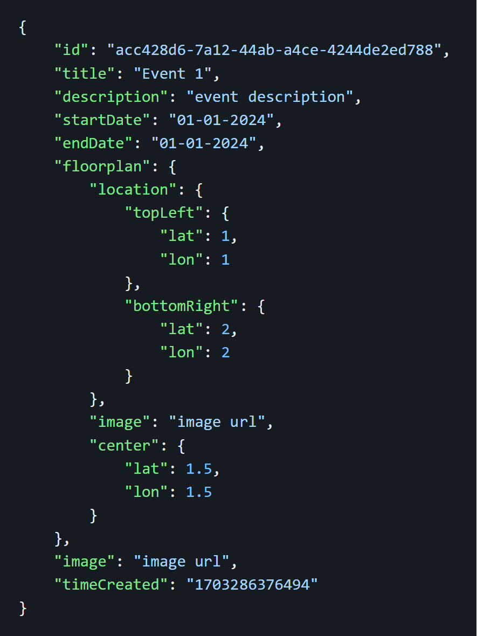
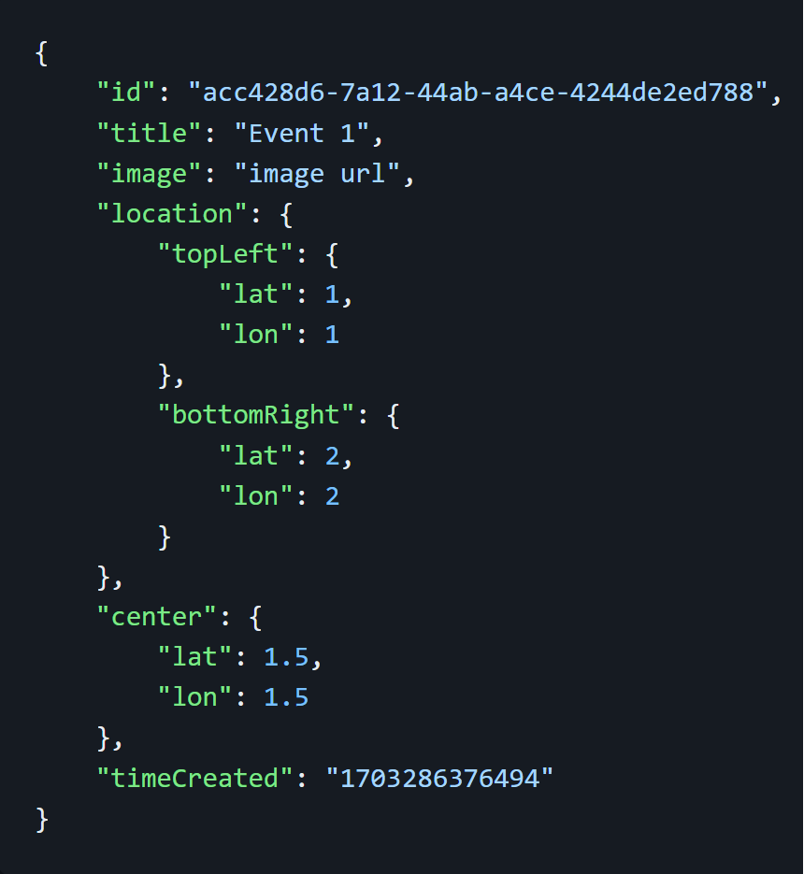
Scope – Refactoring
Better Code
Cleaner Code
Adapt to changes

Slide 5
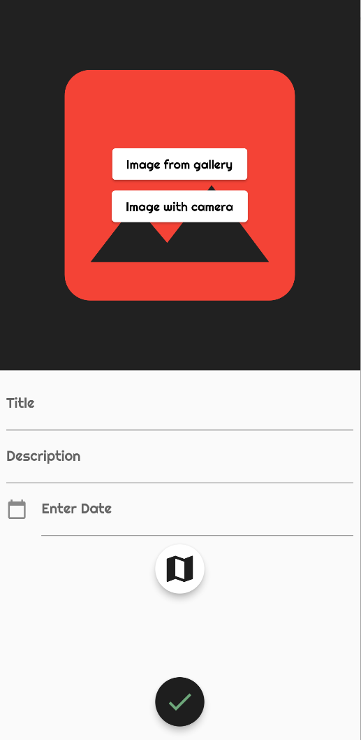
Modifying events
Floorplans -> Whole event
Floorplans part of event
Overview of events

Slide 6
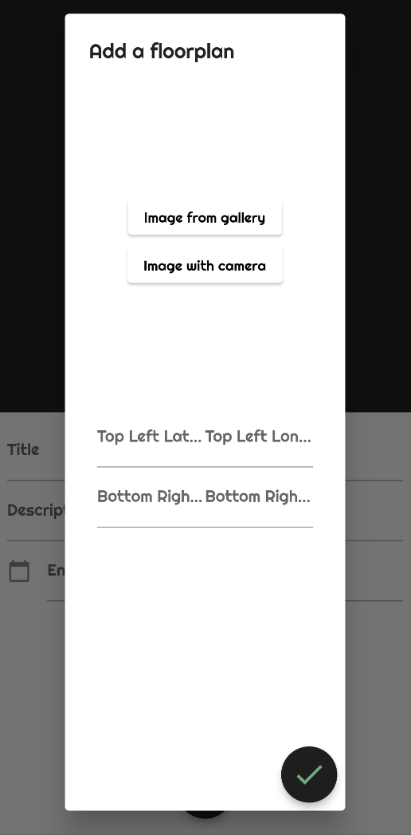
Modifying events
Title
Description
Start date & end date
Floorplan

Slide 7
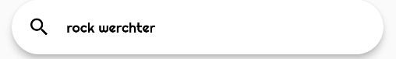
Modifying events
Events you’re interested in
Find events you like
Save them

Slide 8
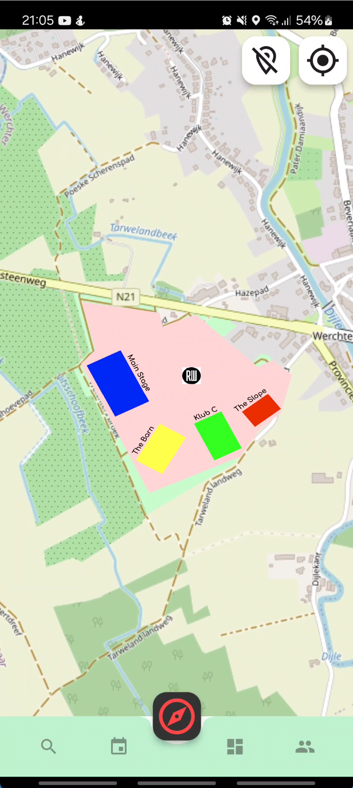
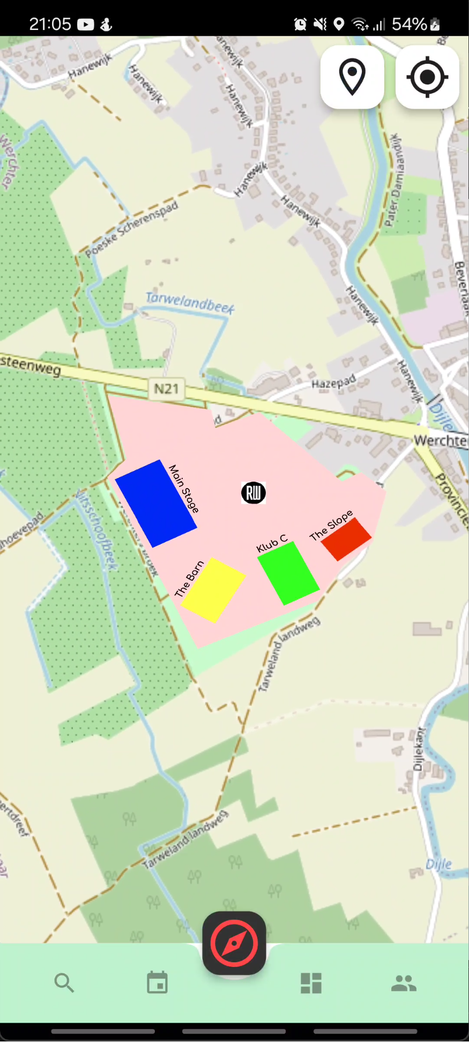
Scope – Pausing Tracking
When you don’t want to be followed
Button on map
Stop Tracking

Slide 9
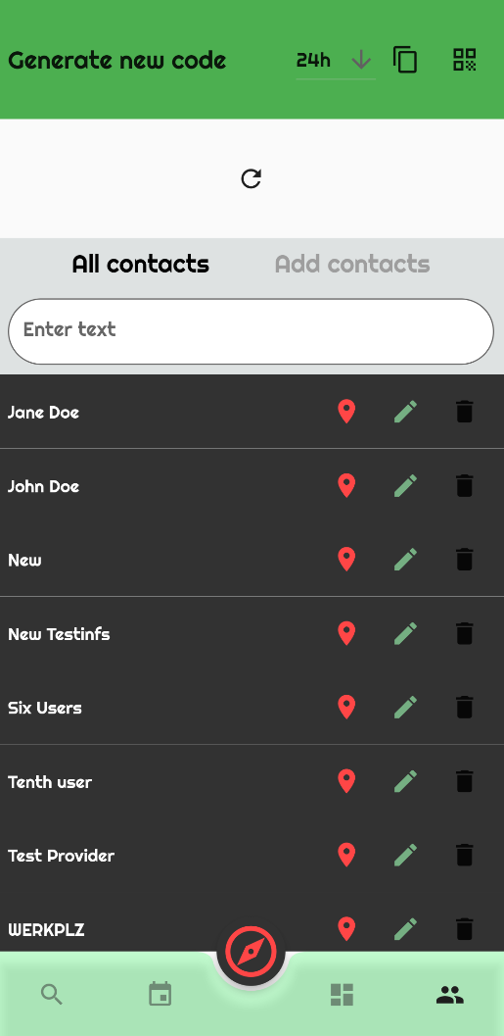
Viewing/adding contacts
An overview of all your contacts
View all your contacts
Locate, edit & delete

Slide 10
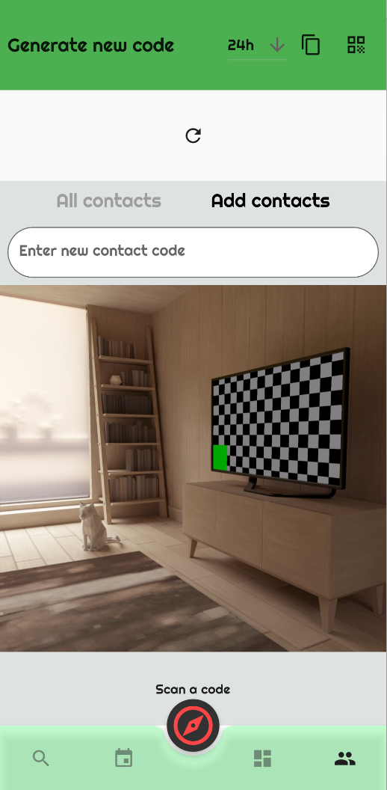
Viewing/adding contacts
New friends
Field to enter unique code
Camera opens automatically for QR

Slide 11
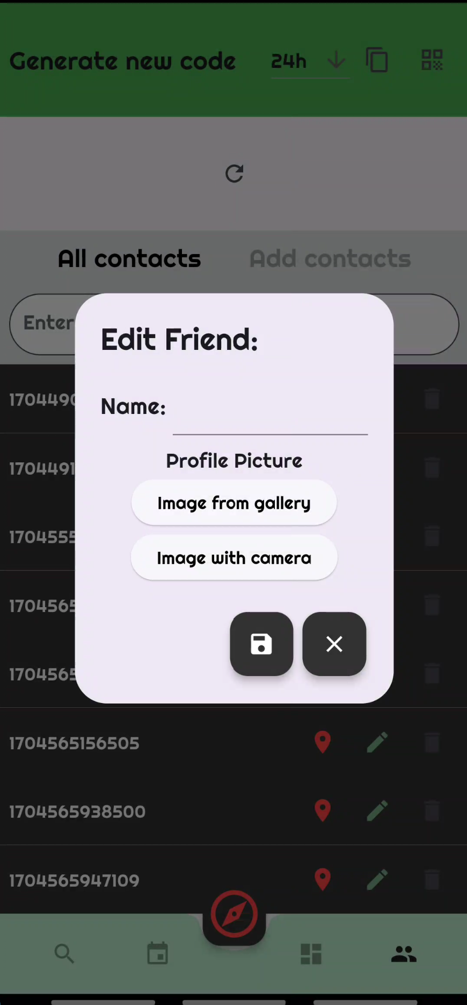
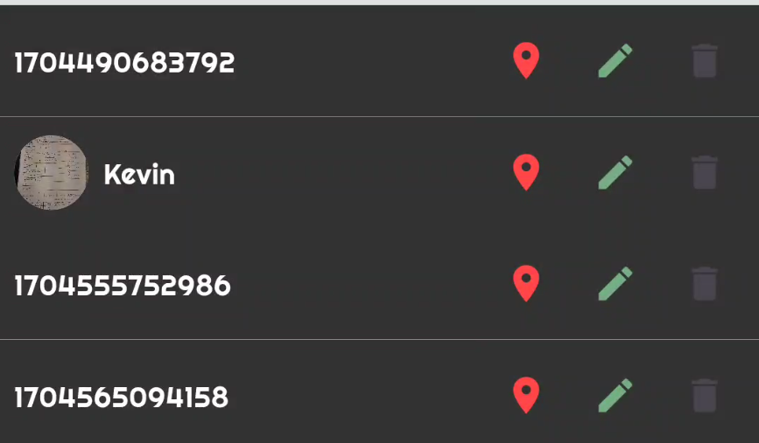
Scope – Adding name & profile picture
Who are my friends?
Add names to codes
Add profile pictures

Slide 12

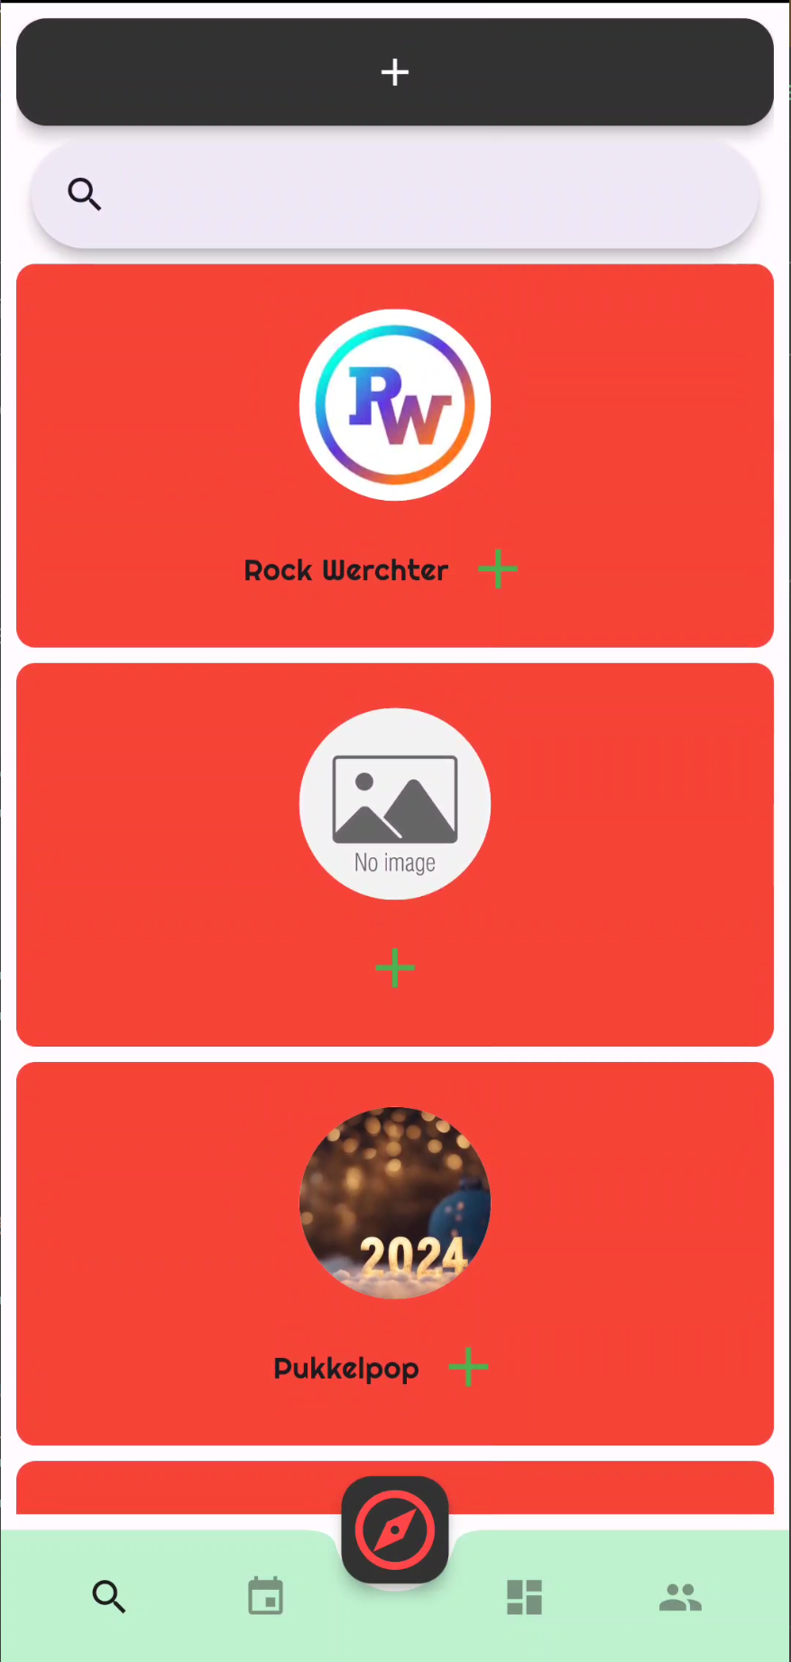
Scope – Layout Finetuning
A New Look
Update Layout
Splash screen animation

Slide 13
Summary
Adding, searching & saving events
Viewing & adding new contacts

Slide 14
Next steps
Last sprint
Finetuning code (searching for & solving bugs)
Hand-over

Slide 15
Thank you
Any questions?

